Slide 1
Proposal for a Special Edition on
Strengthening Information Society Research Capacity Alliance (SIRCA)
Maria Soledad Ramirez Montoya and Elsa Estevez
SIRCA Boot camp
Cape Town, South Africa
10 December 2013

Slide 2

OUTLINE
1 | Motivation
2 | The journal – EJISDC
3 | Details of the special issue
4 | Important dates
5 | Team

Slide 3
MOTIVATION – ADDED VALUE OF OUR RESEARCH
ICT4D research has been criticised in the past:
  for not being theoretically sound,
  for having an impoverished perspective of development, and
  for not being useable by policy makers and practitioners.
Through its capacity building activities, the SIRCA programme has promoted research that addresses these shortcomings.
The theme of the Special Edition of EJISDC is research quality in ICT4D.

Slide 4
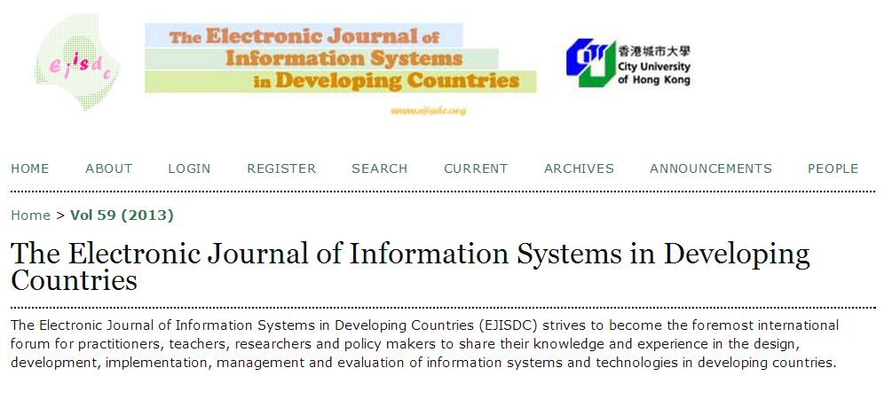
The journal – EJISDC
The Electronic Journal of Information Systems in Developing Countries (EJISDC) strives to become the foremost international forum for practitioners, teachers, researchers and policy makers to share their knowledge and experience in the design, development, implementation, management and evaluation of information systems and technologies in developing countries.
[https://www.ejisdc.org/ojs2/index.php/ejisdc]

Slide 5
PAPERS
We are particularly interested in papers presenting findings of the research work you have conducted as part of the SIRCA Programme demonstrating:
a sound research methodology – including research questions clearly formulated to solve a relevant ICT4D problem and presentation of research results produced through rigorous data-collection and -analysis activities
rich contributions for knowledge transfer based on empirical evidence
  how research results can influence the greater Information Society
  trends, linkages, and dis-connects in the impact of Information Society/ICT4D research on development policies, law, public opinion, and practices
  impact of ICTs in the Global South within the fields of, including but not limited to, education, gender, health, livelihoods, poverty.

Slide 6
REQUIREMENTS
HIGH QUALITY RESEARCH:
Having theoretical foundations Presenting results based on empirical evidences – analyzed quantitatively or qualitatively Presenting meaningful contribution to science – to advance knowledge Explaining how results could be transfer – through generalization or applications to other contexts/domains

Slide 7
SUBMISSIONS
Submissions are sought from all participants in the SIRCA programme, especially those that have participated in the second phase.
We also seek joint contributions from the various collaborators and mentors.

Slide 8
GUIDELINES
Submissions of around 8,000 -10,000 words should be original and previously unpublished.
They will be peer-reviewed by a review panel in the regular fashion.
Involvement in the SIRCA programme does not constitute an automatic acceptance of submitted work.
Manuscripts should describe in detail the research that has been conducted under the guidance provided by the programme as well demonstrating how it addressed some of the previously reported shortcomings in ICT4D research.

Slide 9
IMPORTANT DATES
October 18, 2013 | Indication of interest (written):
January 15, 2014 | Submission of the first draft
January 15-16, 2014 Link to connection be sent on 18-12-2013 Link to the video to be sent on 16-01-2014 | Writing for Academic Journals (Roger Harris) 09:00 am Singapore (16 -01-2014) http://es.calcuworld.com/conversores/conversor-de-husos-horarios/ Example: 09:00 Manila (16-01-2014) 19:00 Mexico (15-01-2014) 03:00 Johannesburg (16-01-2014)
January 27, 2014 ** EXTENDED ** | Paper submission
April 2014 | Notifications to authors
May 2014 | Revised paper submission (final manuscript)
June 2014 | Notification of review results
July/August 2014 | Target publication date

Slide 10
TEAM
GUEST CO-EDITORS
Dr. Maria Soledad Ramirez Montoya | Tecnológico Monterrey, México
Dr. Elsa Estevez | Center for Electronic Governance at United Nations University
EDITORIAL SUPPORT TEAM
Dr. Roger Harris | Co-editor in Chief, EJISDC
Dr. Arul Indrasen Chib | Senior Editor, EJISDC; Nanyang Technological University
Krish Raghav | Singapore Internet Research Center

Slide 11
Questions?

Slide 12
Many thanks!
Marisol – solramirez@tecvirtual.mx
Elsa – elsa@iist.unu.edu

