Slide 1

The Impact of ICT4D Research on Policy and Practice:
Lessons from International Development
Roger Harris

Slide 2
Two communities
Researchers, practitioners, and policy makers live in parallel universes…
…with different values, languages, time-frames, reward systems and professional ties
Researchers
Practitioners and Policy-makers
  puzzle why there is resistance to policy change despite clear and convincing evidence;
  generally do not see policy engagement as part of their role;
  face strong organizational disincentives that dissuade them from engaging in outreach beyond the scientific community;
  face structural barriers to engaging in knowledge translation activities.
  lament that researchers do not speak with one voice;
  bemoan the inability of researchers to make their findings accessible and digestible in time for policy decisions;
  lack confidence in their researchers;
  regard research-based evidence as a minor factor when policies for development are formulated and practices shaped.

Slide 3
Two impacts
Researchers’ impact
Policy and practitioners’ impact
  usually reflected by the impact factor of the journal in which the research report is published;
  impact factor is a measure of the average number of citations that have been made to recently published papers;
  frequently used as a proxy for the relative importance of a journal within its field.
  for research to have any impact, the results must inform and shape policies and programmes, and be adopted into practice;
  use or consideration of research findings for actual outcomes of social change;
  emphasizes the need for economic and societal impacts.

Slide 4
Summary Literature Review
Intent to influence must be expressly included among the research objectives
Need for closer relationships between researchers and research users, especially policy-makers. Public engagement processes draw on a range of methods and approaches
Crucial for researchers to communicate effectively in a language that policymakers understand
Intent
Engage-ment
Comm-unication
Researchers are advised to participate in activities that would stimulate demand for their outputs,
Participatory communication processes in development use ICTs for rapid, participant-driven production and communication of research, as it unfolds
Demand
ICTs
Policy and practice
Knowledge intermediary organisations synthesise, interpret and communicate research
Research is more likely to contribute to policy if the evidence fits within the political and institutional limits and pressures of policy makers
Political Context
Interm-ediaries
Individual who invests time and resources to advance a position or policy
Incentives
Policy Entrep-reneurs
Incentives are needed for researchers to engage effectively with users of their research
Networks
Research findings and concepts circulate and are gradually filtered through various policy networks
Notes:
Researchers need to have the intent of influencing policy and practice.
They need to produce high-quality research.
Academic incentive and reward systems need to move away from a focus on publishing and citation-counting and more towards the promotion of research that achieves social and economic impact.
Research results need to be better communicated to wider audiences, including the public, civil society and policy-makers.
ICTs need to be used more effectively to improve research communication and to allow researchers to engage with other stakeholders in processes of knowledge sharing.
Intermediaries between researchers and practitioners - individuals and/or organisations - effectively promote research findings to wider audiences where researchers themselves do not (for whatever reason).
The role of policy entrepreneurs is fostered among suitable researchers and research institutions.
Formal or informal networks of researchers, practitioners and policy-makers exist to facilitate interchanges among stakeholders and promote the take-up of research results.
Researchers engage with the political context of their work.
Researchers engage with the users of their research in order to understand the demand- side dynamics of the use of their research in practice and policy circles.
There is effective engagement between researchers, practitioners and policy-makers that serves to overcome the various barriers between them.

Slide 5
Lessons for researchers
Interact with stakeholders to ensure relevance of research questions and outputs.
Identify uptake pathways as part of project design.
Design projects to meet end users’ needs and aspirations.
Share and publish experiences of how research results have been ‘translated’ or used for a non-scientific audience.

Slide 6
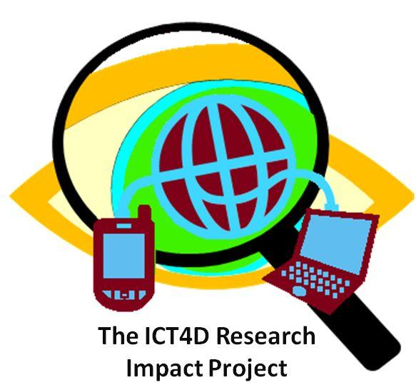
The ICT4D Research Impact Project

Slide 7
The ICT4D Research Impact Project
Intent to influence
Amount of communic-ation with the public
Understanding of research impact
The Impact of Research on
ICT4D Policy
Use of ICTs
Involvement of Interm-ediaries
Degree to which considered to be a policy entrepreneur
Degree of participation in networks
The Impact of Research on
ICT4D Practice
Influence of incentives
Level of consideration of the political context
Cultural affinity with research users
Extent of demand for research
Extent of engagement with research users

Slide 8
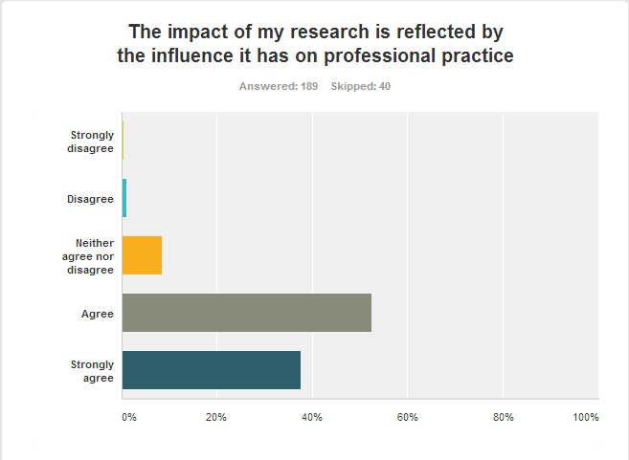
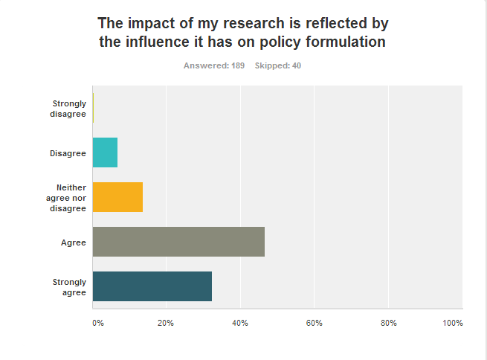
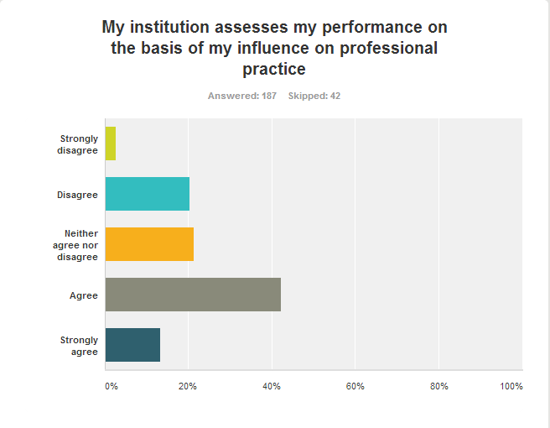
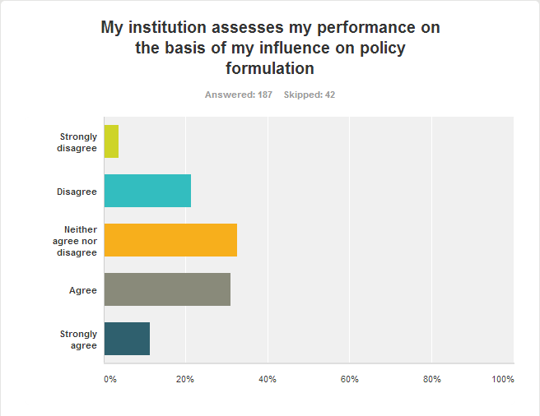

Slide 9
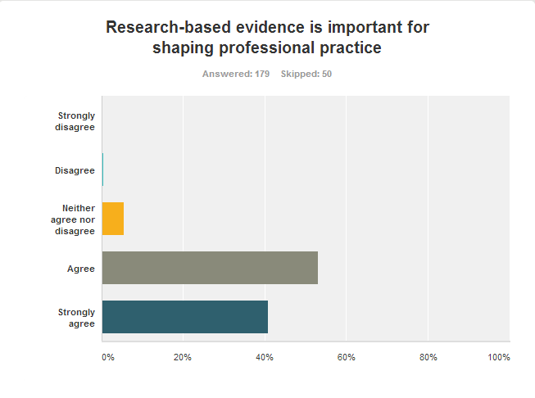
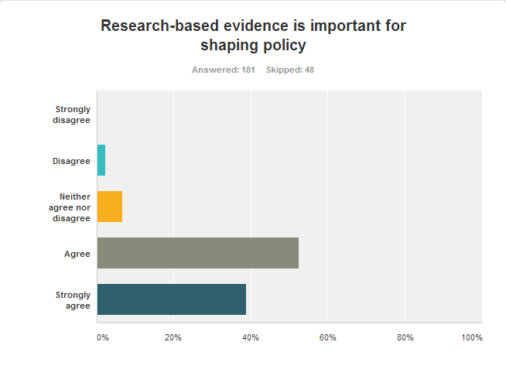
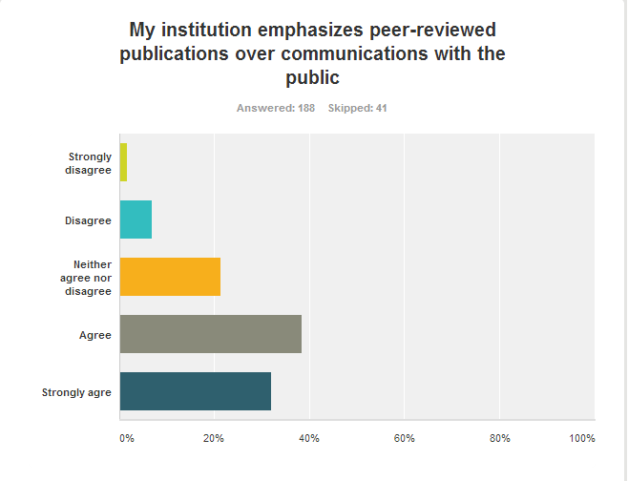
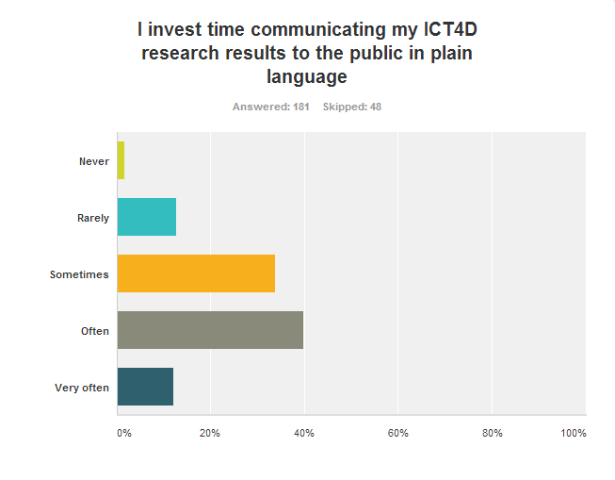
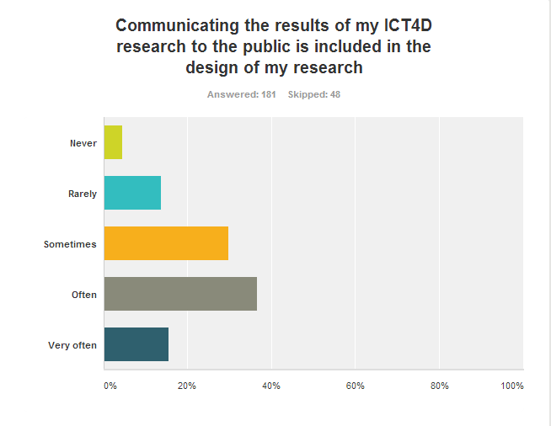

Slide 10
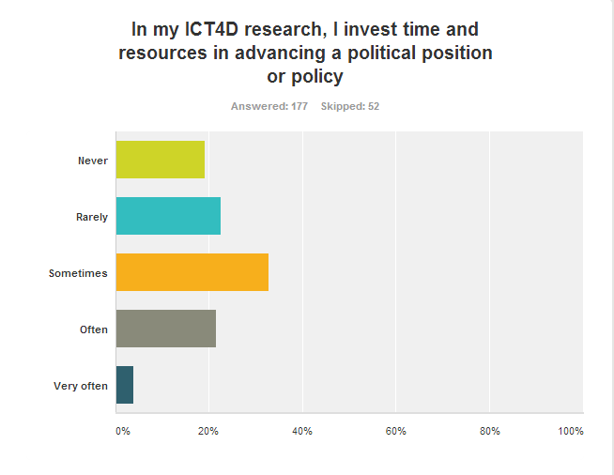
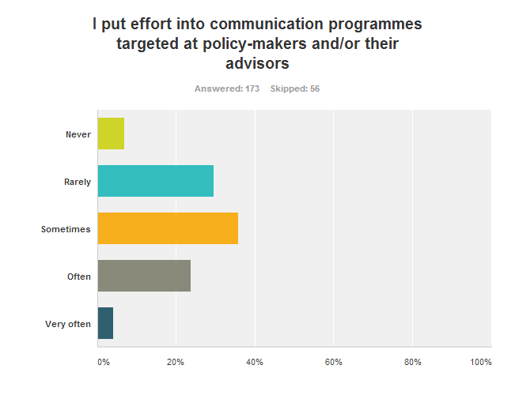
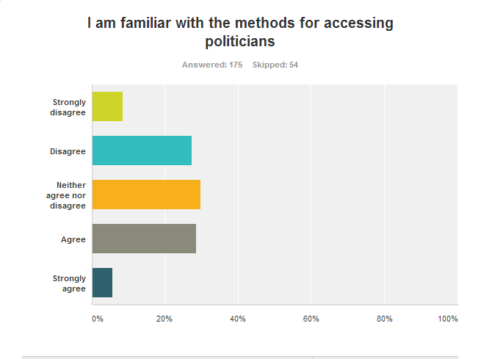
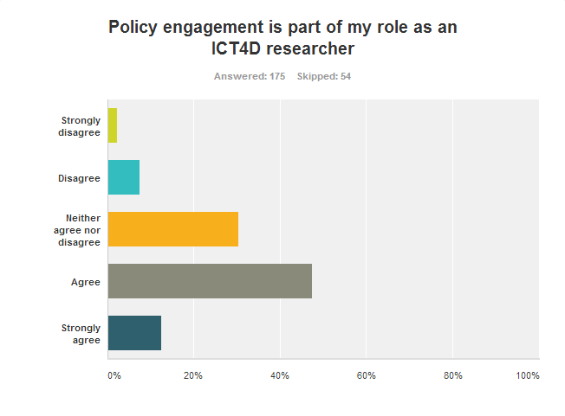

Slide 11
Panel discussion

Slide 12
Group discussions
Do you regard it as your role to influence policy and practice?
Are you rewarded for doing so?
Does your institution provide incentives for you to communicate with the general public?
Does your research budget accommodate activities for promoting your research findings among politicians/practitioners?

